Slide 1
Recurrent Neural Networks for Speech Recognition
CSCI 4961/6961 Group 6

Slide 2
Paper chosen: http://www.cs.toronto.edu/~hinton/absps/DRNN_speech.pdf
Who are the authors, and the date and venue of publication?
What is the problem that is addressed (pick one, if the paper addresses more than one), and why is it interesting or useful?
What is the main result of the paper?
Describe the result or algorithm and motivate it intuitively.
What is the cost (time, space, or some other metric) of this algorithm, and how does it compare to prior algorithms for the same problem? (and similarly, for non-algorithmic results)
What performance guarantees, if any, are provided for the algorithm?
Give an accurate description of the analysis given in the paper: in simple cases this may be a tour through the entire argument; when this is not possible, focus on explaining a core lemma/theorem that supports the claim of the paper.
Provide an empirical evaluation of the algorithm: compare its performance to reasonable baselines, and explore relevant aspects of the algorithm (its variability, sensitivity to relevant properties of the input, etc.). If presenting a non-algorithmic result and it is possible, provide some experimental evidence of its sharpness or lack thereof

Slide 3
“Speech Recognition with Deep Recurrent Neural Networks”
Written by Alex Graves, Abdel-rahman Mohamed and Geoffrey Hinton in 2013
From the Department of Computer Science at University of Toronto
Graves, A., Mohamed, A. R., & Hinton, G. (2013, May). Speech recognition with deep recurrent neural networks. In 2013 IEEE international conference on acoustics, speech and signal processing (pp. 6645-6649). IEEE.

Slide 4
Model Definition

Slide 5
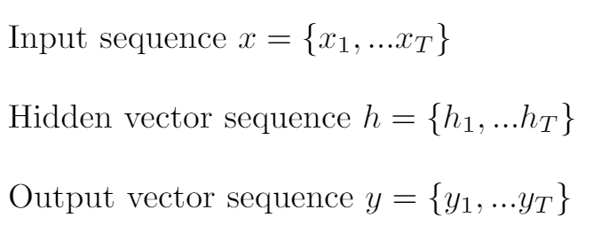
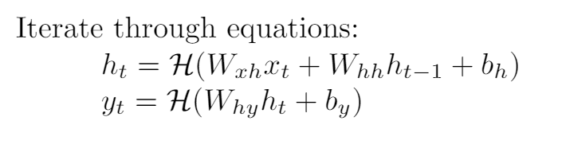
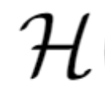
Recurrent Neural Networks
denotes the hidden layer function
Notes:
Given an input sequence x={x1,...,xT}, a recurrent neural network computes the hidden vector sequence h={h1,...,hT} and output vector y={y1,...,yT}. It does this by iterating, from t=1 to T through the following two equations, where W is the weight matrices and b is the bias vectors. For example, W_{xh} denotes the weights between the input layer and a hidden layer, and b_h denotes the bias of the hidden layers. 𝓗 denotes the hidden layer function, often an elementwise application of a sigmoid function.

Slide 6
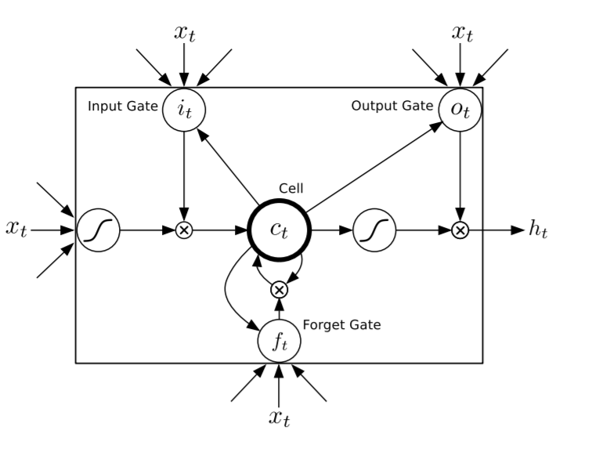
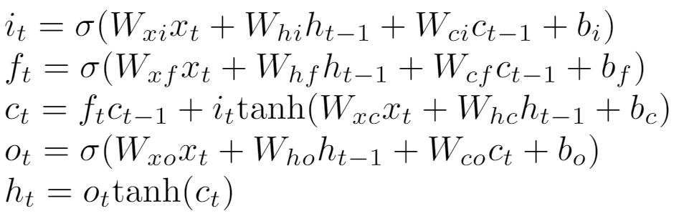
Long Short-Term Memory
A common implementation for the hidden layer function, which allows for processing of sequences such as speech, where a sound can be stored across multiple input segments.
The implementation found in the paper:

Slide 7
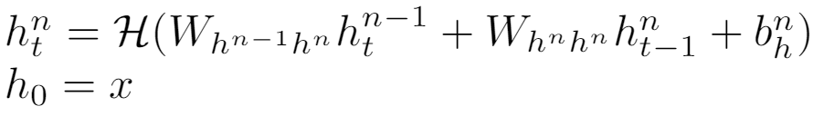

Deep Recurrent Neural Networks
Deep RNNs are created by stacking multiple hidden layers on top of eachother.
The stacking of layers may provide a similar effect as a deep NN, as this method introduces distinct inter-layer weights, rather than just the recurrent layer weights
The concept of Deep RNNs were introduced and reported on for the first time in this paper
Notes:
This paper investigates the use of deep recurrent neural networks for speech recognition. A deep recurrent neural net incorporates the multiple levels of layers of a deep neural network and the long-range time dependence of a recurrent neural net. This paper aims to address the question of whether RNNs would benefit from stacking multiple recurrent layers on top of eachother. To do this, they introduce deep long short-term memory rnns and evaluate their performance for speech recognition.

Slide 8
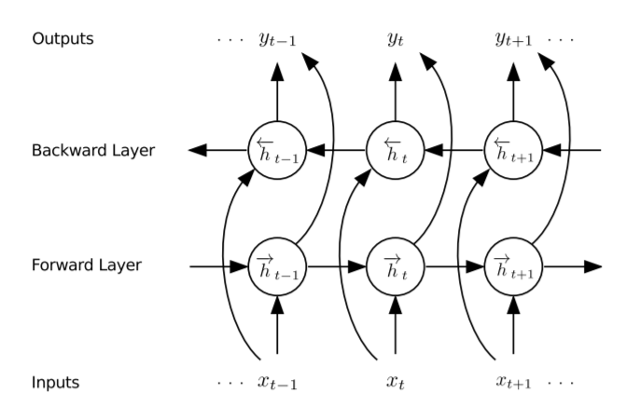
Bidirectional RNN
This paper also uses Bidirectional RNNs, which uses “future” information as well as past information, by running a parallel hidden layer that iterates x from T to 1 instead of 1 to T

Slide 9
Network Training

Slide 10
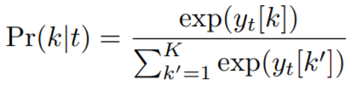
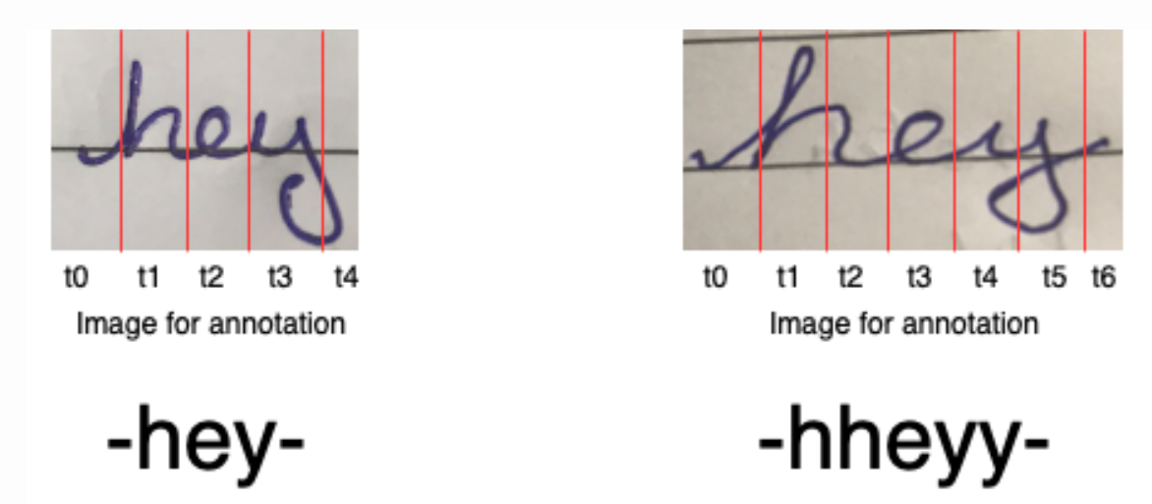
Connectionist Temporal Classification (CTC)
CTC is an function for obtaining a differentiable probabilistic output from RNNs
Method was also developed by Alex Graves in 2006
Uses a “blank” output along with a forward-backward summation algorithm to handle time sequences that have the same output

Slide 11
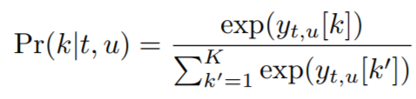
RNN Transducer
A model architecture also proposed by Alex Graves one year prior
Uses two RNNs, one called the transcriber and another called the predictor
In this paper, the transcriber network is the Deep RNN and the predictor is another RNN that uses the output from the CTC function to predict the alignment of characters to produce the output
The predictor models use a modified BFS algorithm called Beam Search to find optimal probability distributions that take into account all combinations of time input and possible outputs

Slide 12
Paper Results and Conclusions

Slide 13
Dataset used
TIMIT corpus for phoneme recognition
630 speakers reading phonetically hard sentences
Audio files labeled with phonetic spellings
Commonly used in speech recognition and transformation learning

Slide 14
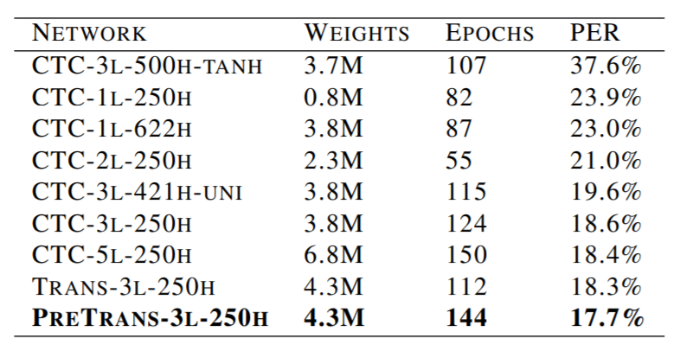
Model Comparison
CTC vs. Transduction vs. Pre Transduction
1 vs 3 vs 5 layer Deep RNN
Various sizes LSTM nodes per layer
All trained with SGD w/ momentum
All used beam search with 100 width
-tanh and -uni did not use LSTM and used respective H function

Slide 15
Results/Conclusions
Increase in amount of hidden layers for CTC decreased error rate
Depth of Deep RNN affects the results more than the size of the hidden layer
The data was well represented by this model and the combination of Deep, Bidirectional RNNs with LSTMs provided state of the art error % (It was the best at the time)

Slide 16
Implementation

Slide 17
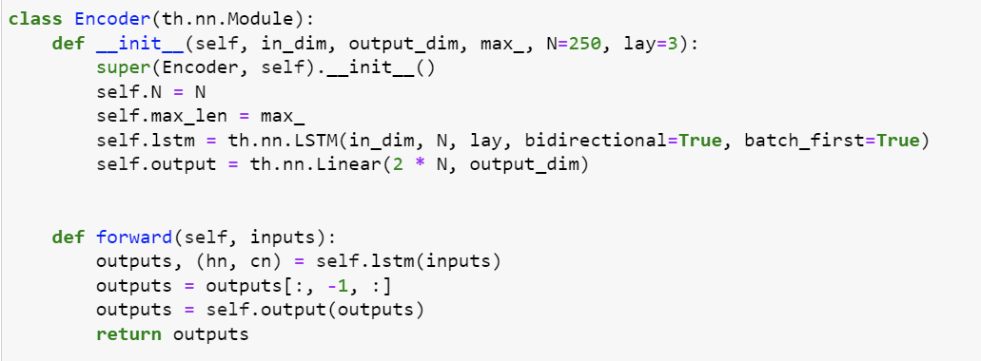
Encoder/Decoder

Slide 18
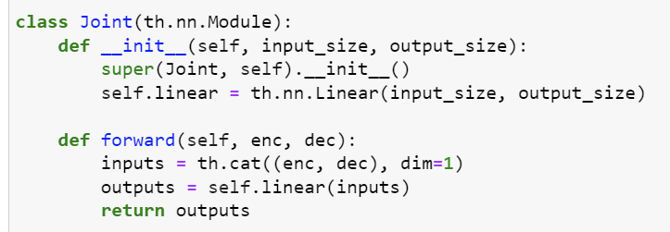
Combination

Slide 19
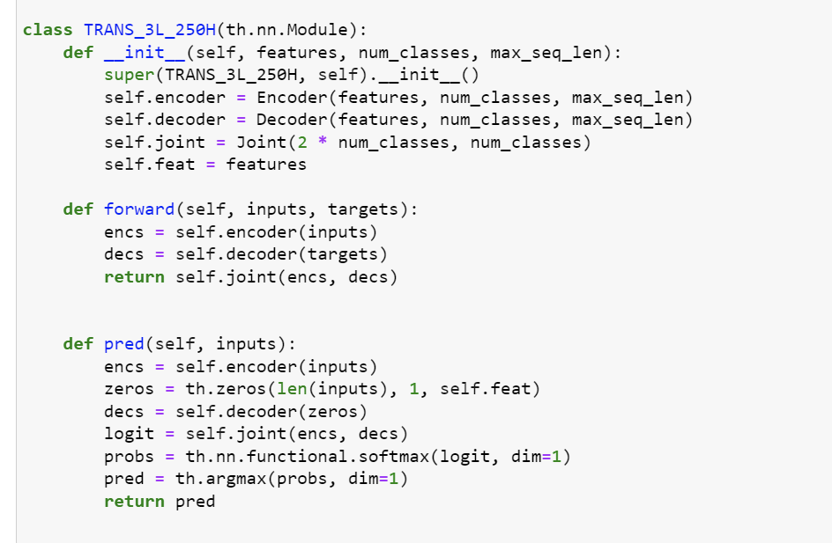
Full

